Slide 1
Installing Jupyter
Notebook
Mr. Hatcher
1271

Slide 2
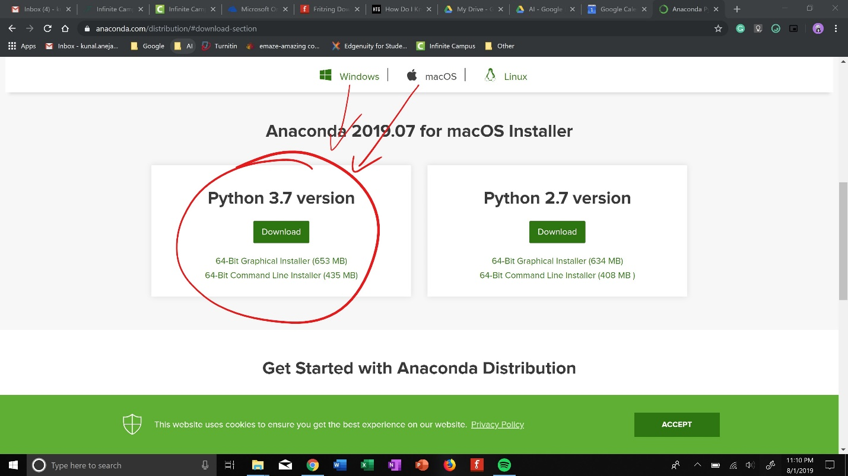
Installing Anaconda
https://www.anaconda.com/distribution/
Just search up anaconda download
** make sure you scroll down**

Slide 3
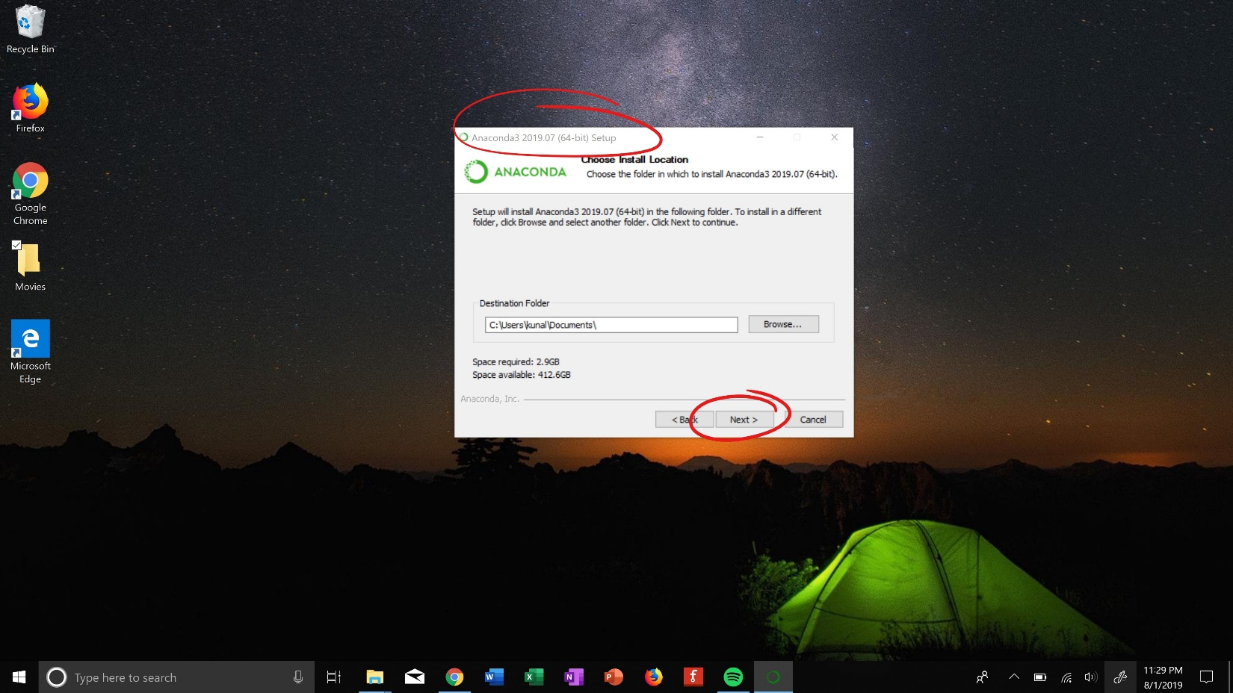
Installing Anaconda
Go through process SLOWLY
Pic a proper place to save it***

Slide 4
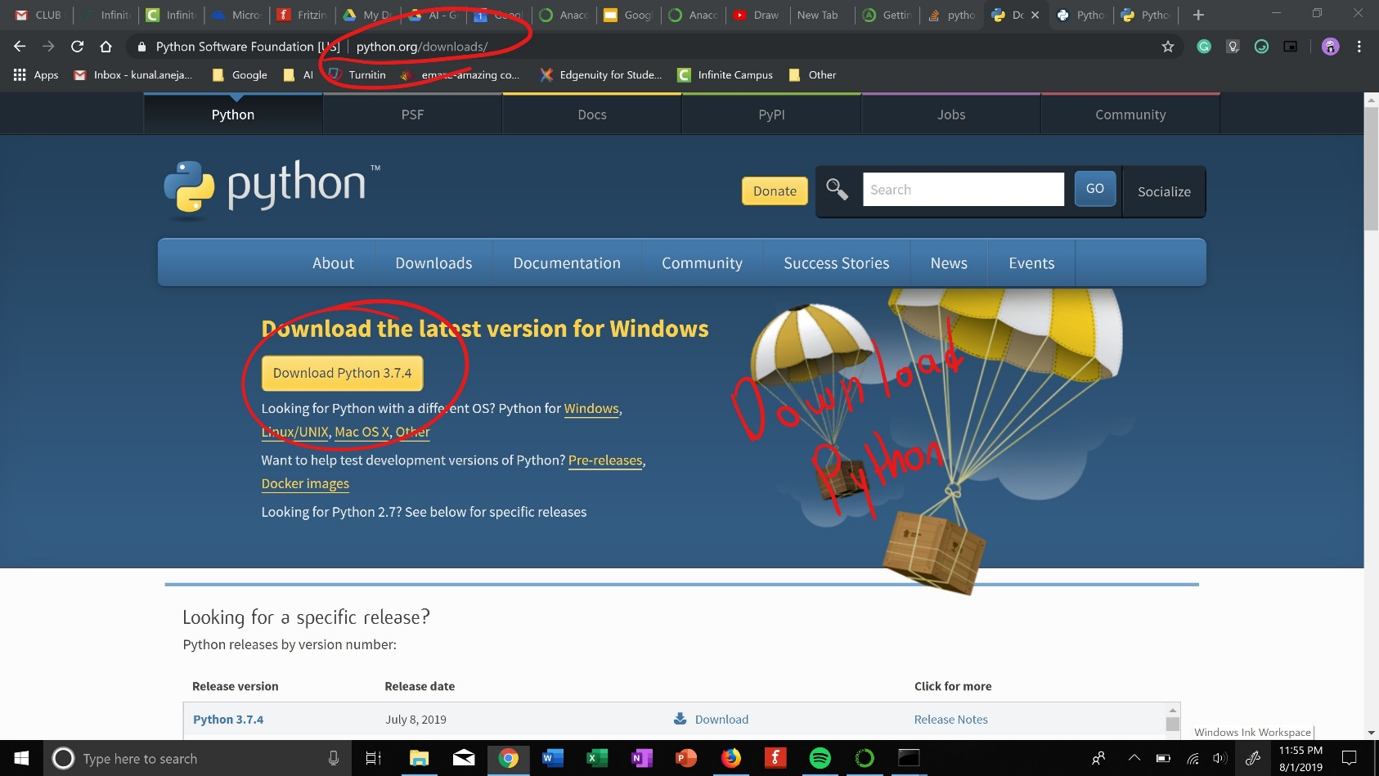
Installing Anaconda
Download Python
Just search it up

Slide 5
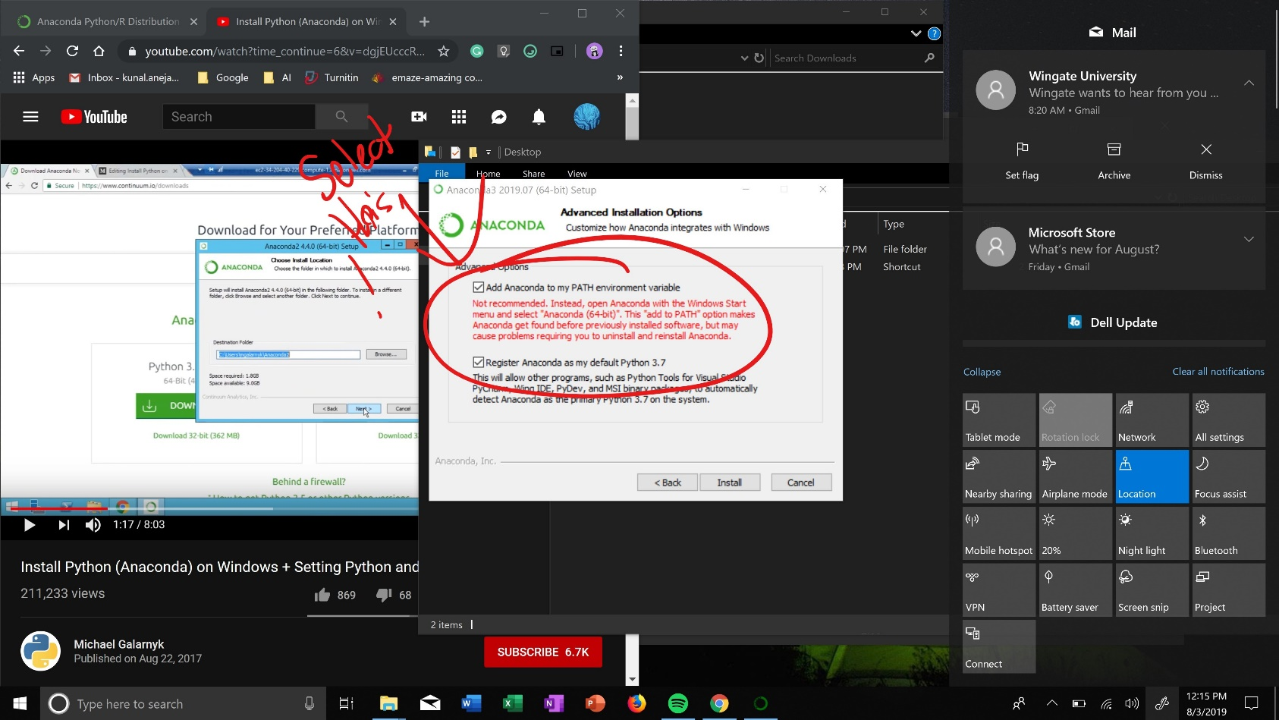
Installing Anaconda
MAKE SURE YOU DO THIS
ADD ANACONDA TO MY PATH ENVIORMENT VARIABLE

Slide 6
Running Anaconda
Go to command line and type in “jupyter notebook”
Make sure you have pip installed
  Install all the libraries
    https://www.youtube.com/watch?v=Fcc_jemaoNU

